Slide 1

课时练习
模块八 第一章 第三节

Slide 2
一、翻译下列词组。
1. 开一家服装店 __________________________
2. 选择合适的衣服 ________________________
3. 简单的款式 ______________________
4. 形成鲜明的对比 ____________________
open a clothing store
choose suitable clothing
simple styles
have big contrasts

Slide 3
一、翻译下列词组。
5.（穿）在某人身上很好看 ______________________
6. 显得强壮丰满 _______________________________
7. 看起来更苗条 _____________________________
8. 做得好； 进展好 ____________________________
look good on sb.
appear strong and full
look slimmer
do well

Slide 4
二、用括号内所给单词的适当形式填空， 每空一词。
1. —I’ve just passed my driving test!
— _______________(congratulation)!
2. China _________ (succeed) in sending six astronauts (宇航员) to its space station in 2021.
3. When he left school, he went into ___________ (busy) with his brother.
Congratulations
succeeded
business

Slide 5
二、用括号内所给单词的适当形式填空， 每空一词。
4. Mrs. Green is one of the most regular __________ (customer) at the fish market.
5. It was no hardship to walk home on such a ______ (love) evening.
customers
lovely

Slide 6
三、情景交际。
3. 得知表姐开了一间服装店， 你可以这样祝她生意兴隆：
I hope _______________________________________?
your business goes/does well

Slide 7
三、情景交际。
1. 和朋友碰面前， 你想知道他穿着什么衣服， 可以这样问：
_______________________________________?
2. 顾客来买衣服， 你想知道他要什么码， 可以这样问：
_______________________________________?
What (clothes) are you wearing
What size do you take/wear/want

Slide 8
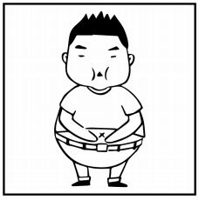
四、看图写话。
1. short, with, waist
The man/He is short with a broad waist.

Slide 9
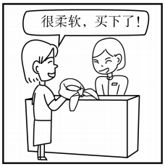
四、看图写话。
2. such … that …, scarf
It’s such a soft scarf that the woman wants to buy it./
It was such a soft scarf that she bought it. .

Slide 10
四、看图写话。
3. want, choose, for
The woman/She wants to choose a dress for the/a birthday party.

Slide 11
五、熟词生义。
1. develop A. vi.& vt. 发展 B. vi.& vt. 冲洗（相片）
C. vt. 养成（习惯）
_____ (1) Did you ever get the pictures developed?
_____ (2) It’s never too late to develop a reading habit.
_____ (3) China’s high-speed railway developed from nothing.
B
C
A

Slide 12
五、熟词生义。
2. pretty A. adj. 漂亮的 B. adv. 相当
_____ (1) Wuzhen is a very pretty water town in Zhejiang．
_____ (2) The woman seemed pretty pleased with the result.
A
B

Slide 13
五、熟词生义。
3. pocket A. n. 口袋 B. vt. 侵吞； 赚得
_____ (1) She put her watch in her pocket for safe keeping．
_____ (2) It’s simple—we buy them for 5, sell them for 8, and we pocket the difference.
A
B

Slide 14


